Slide 1
Search Engines
Information Retrieval in Practice

Slide 2
Retrieval Models
Provide a mathematical framework for defining the search process
includes explanation of assumptions
basis of many ranking algorithms
can be implicit
Progress in retrieval models has corresponded with improvements in effectiveness
Theories about relevance

Slide 3
Relevance
Complex concept that has been studied for some time
Many factors to consider
People often disagree when making relevance judgments
Retrieval models make various assumptions about relevance to simplify problem
e.g., topical vs. user relevance
e.g., binary vs. multi-valued relevance

Slide 4
Retrieval Model Overview
Older models
Boolean retrieval
Vector Space model
Probabilistic Models
BM25
Language models
Combining evidence
Learning to Rank

Slide 5
Boolean Retrieval
Two possible outcomes for query processing
TRUE and FALSE
“exact-match” retrieval
simplest form of ranking
Query usually specified using Boolean operators
AND, OR, NOT
proximity operators also used

Slide 6
Boolean Retrieval
Advantages
Results are predictable, relatively easy to explain
Many different features can be incorporated
Efficient processing since many documents can be eliminated from search
Disadvantages
Effectiveness depends entirely on user
Simple queries usually don’t work well
Complex queries are difficult
Νo ranking

Slide 7
Searching by Numbers
Sequence of queries driven by number of retrieved documents
e.g. “lincoln” search of news articles
president AND lincoln
president AND lincoln AND NOT (automobile OR car)
president AND lincoln AND biography AND life AND birthplace AND gettysburg AND NOT (automobile OR car)
president AND lincoln AND (biography OR life OR birthplace OR gettysburg) AND NOT (automobile OR car)

Slide 8
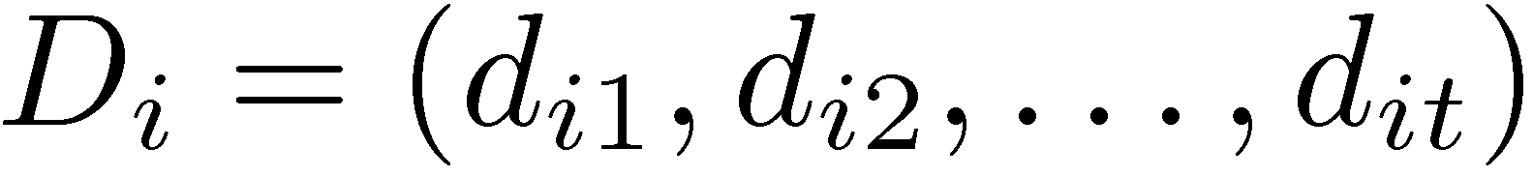
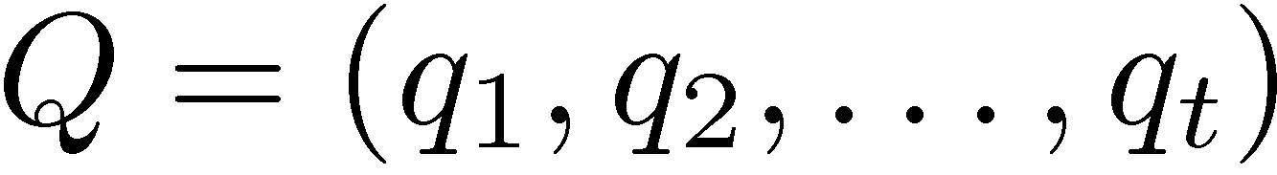
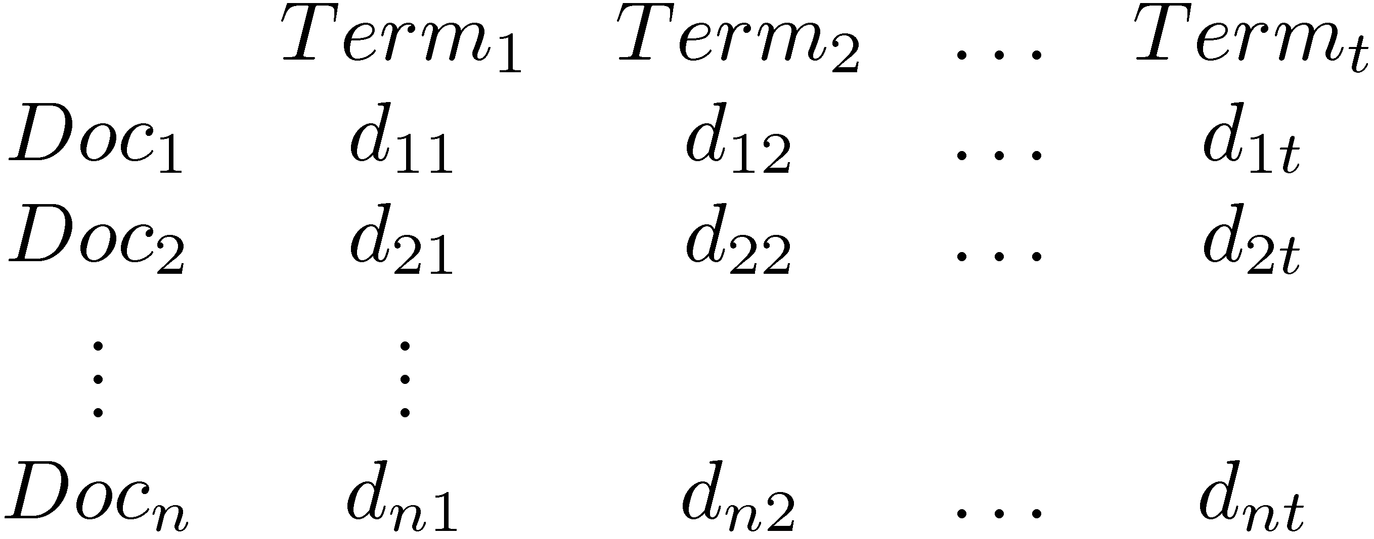
Vector Space Model
Documents and query represented by a vector of term weights
Collection represented by a matrix of term weights

Slide 9
Vector Space Model

Slide 10
Vector Space Model
3-d pictures useful, but can be misleading for high-dimensional space

Slide 11
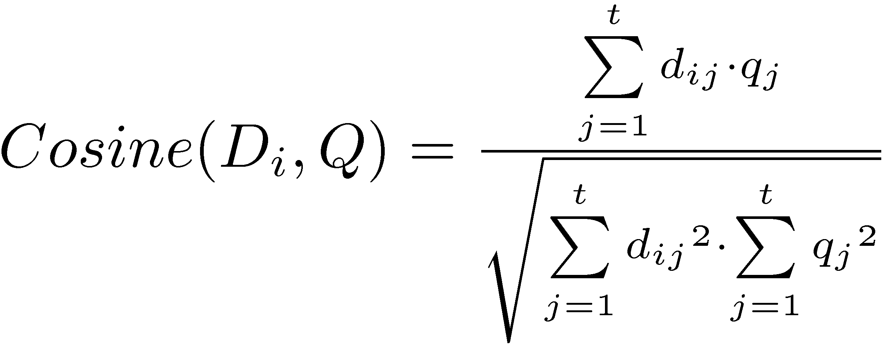
Vector Space Model
Documents ranked by distance between points representing query and documents
Similarity measure more common than a distance or dissimilarity measure
e.g. Cosine correlation

Slide 12
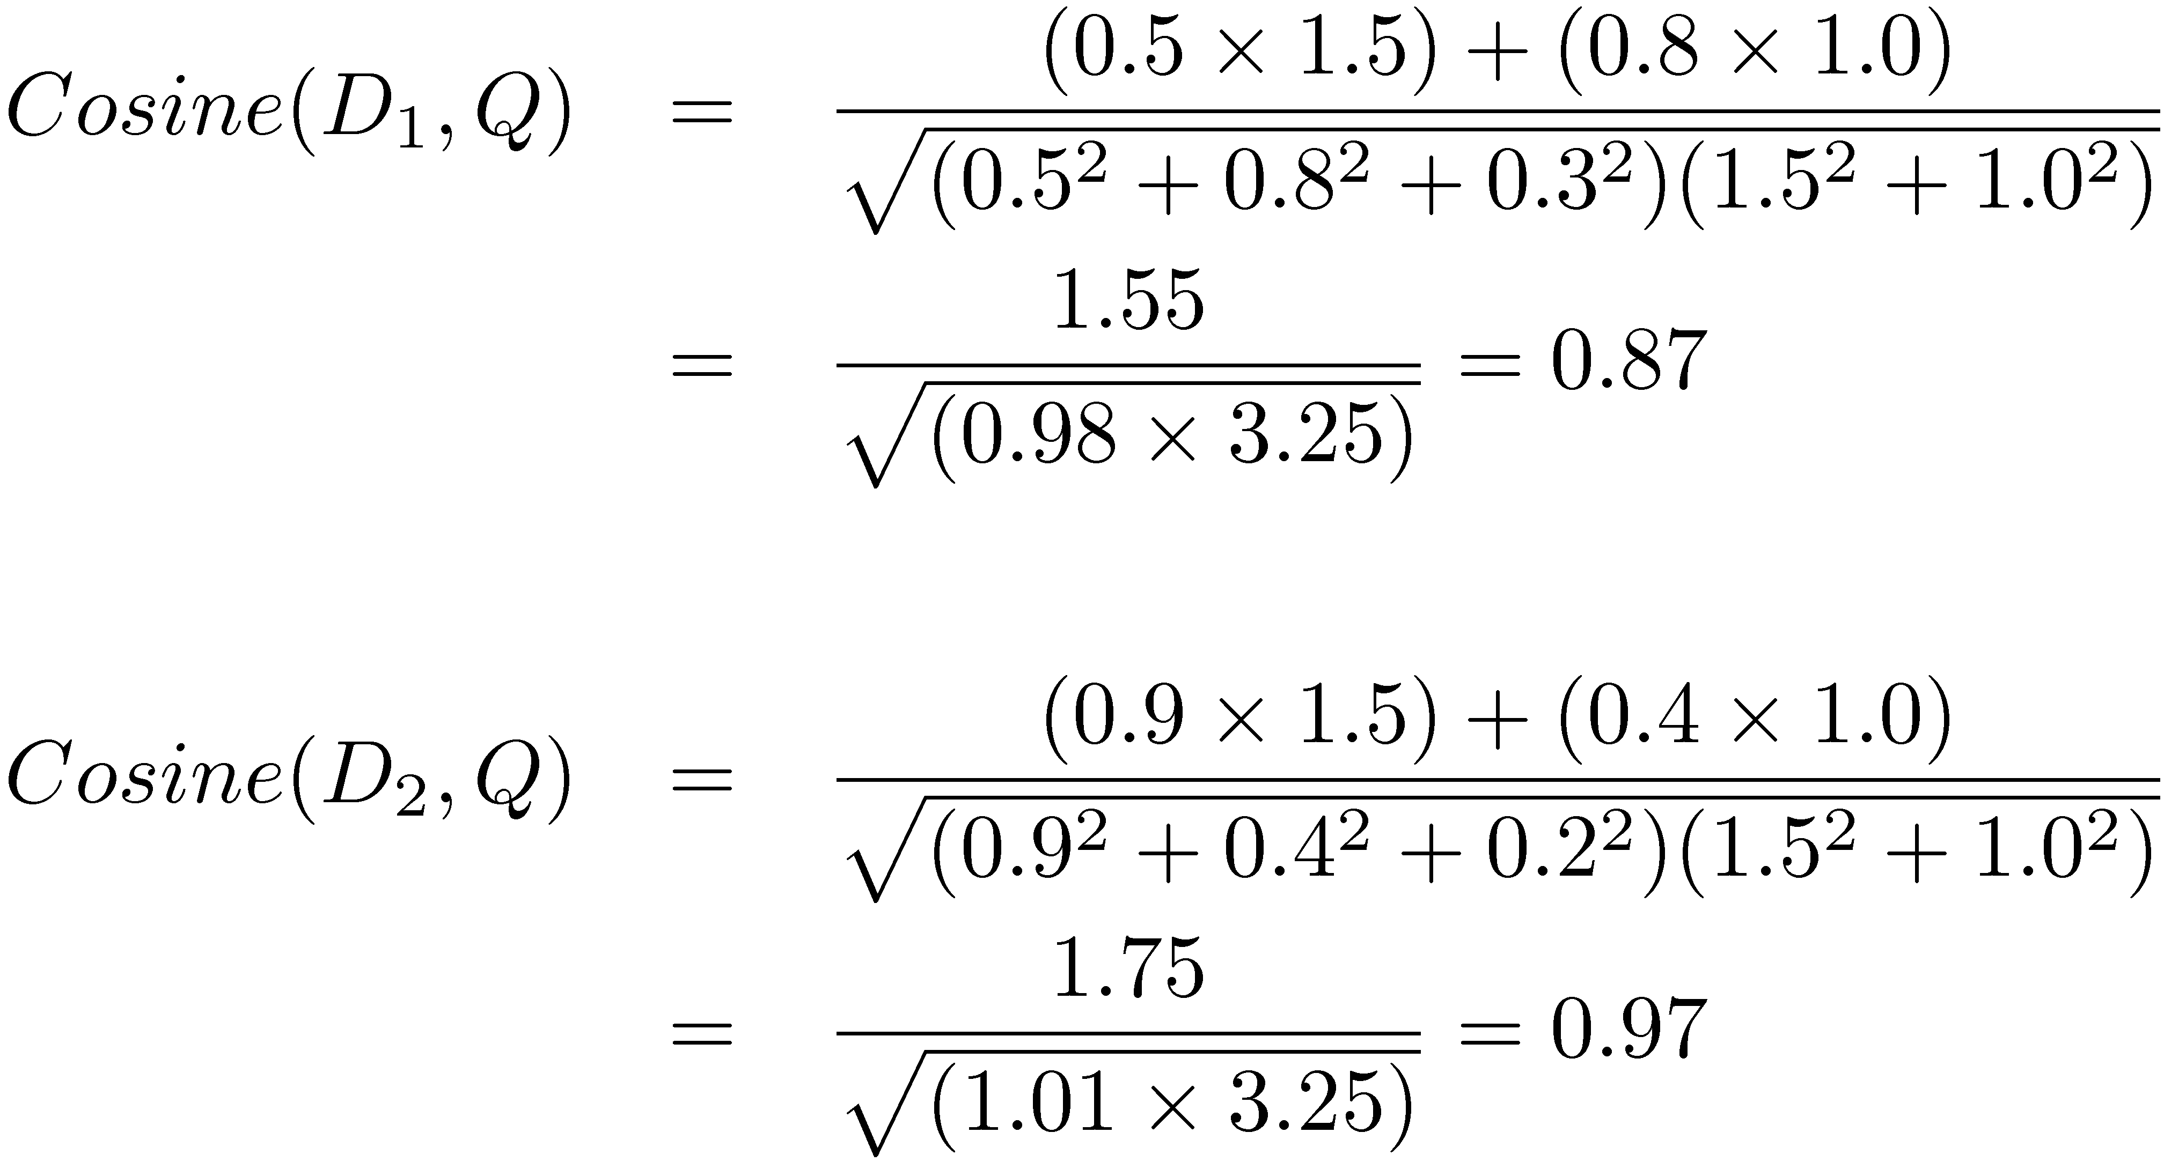
Similarity Calculation
Consider two documents D_{1,} D₂ and a query Q
D₁ = (0.5, 0.8, 0.3), D₂ = (0.9, 0.4, 0.2), Q = (1.5, 1.0, 0)

Slide 13
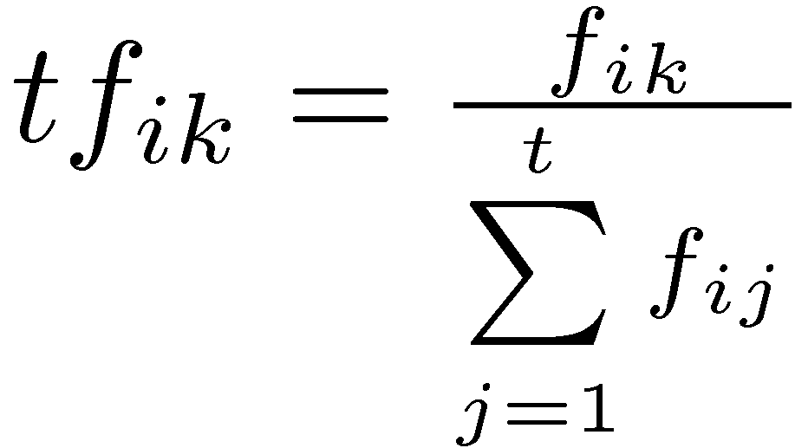
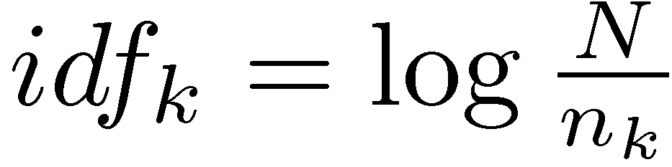
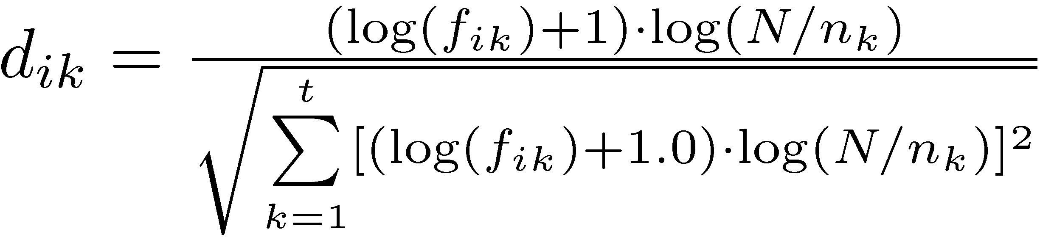
Term Weights
tf.idf weight
Term frequency weight measures importance in document:
Inverse document frequency measures importance in collection:
Some heuristic modifications

Slide 14
Relevance Feedback
Rocchio algorithm
Optimal query
Maximizes the difference between the average vector representing the relevant documents and the average vector representing the non-relevant documents
Modifies query according to
α, β, and γ are parameters
Typical values 8, 16, 4

Slide 15
Vector Space Model
Advantages
Simple computational framework for ranking
Any similarity measure or term weighting scheme could be used
Disadvantages
Assumption of term independence
No synonyms/stemming handling
Ignores order and distance between terms

Slide 16
Probability Ranking Principle
Robertson (1977)
“If a reference retrieval system’s response to each request is a ranking of the documents in the collection in order of decreasing probability of relevance to the user who submitted the request,
where the probabilities are estimated as accurately as possible on the basis of whatever data have been made available to the system for this purpose,
the overall effectiveness of the system to its user will be the best that is obtainable on the basis of those data.”

Slide 17
IR as Classification

Slide 18
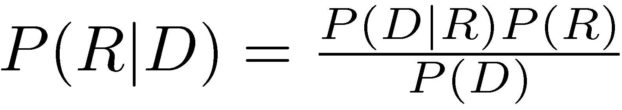
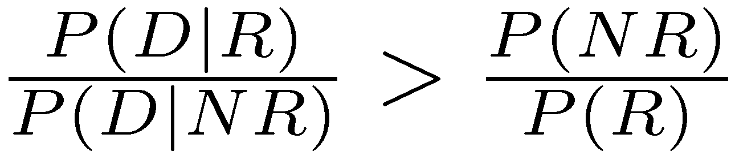
Bayes Classifier
Bayes Decision Rule
A document D is relevant if P(R|D) > P(NR|D)
Estimating probabilities
use Bayes Rule
classify a document as relevant if P(R|D)>P(NR|D)
that is:
lhs is likelihood ratio
In practice, we rank documents by lhs

Slide 19
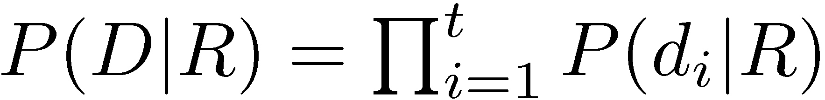
Estimating P(D|R)
Assume independence
Binary independence model
document represented by a vector of binary features indicating term occurrence (or non-occurrence)
p_{i} is probability that term i occurs (i.e., has value 1) in relevant document,
s_{i} is probability of occurrence in non-relevant document

Slide 20
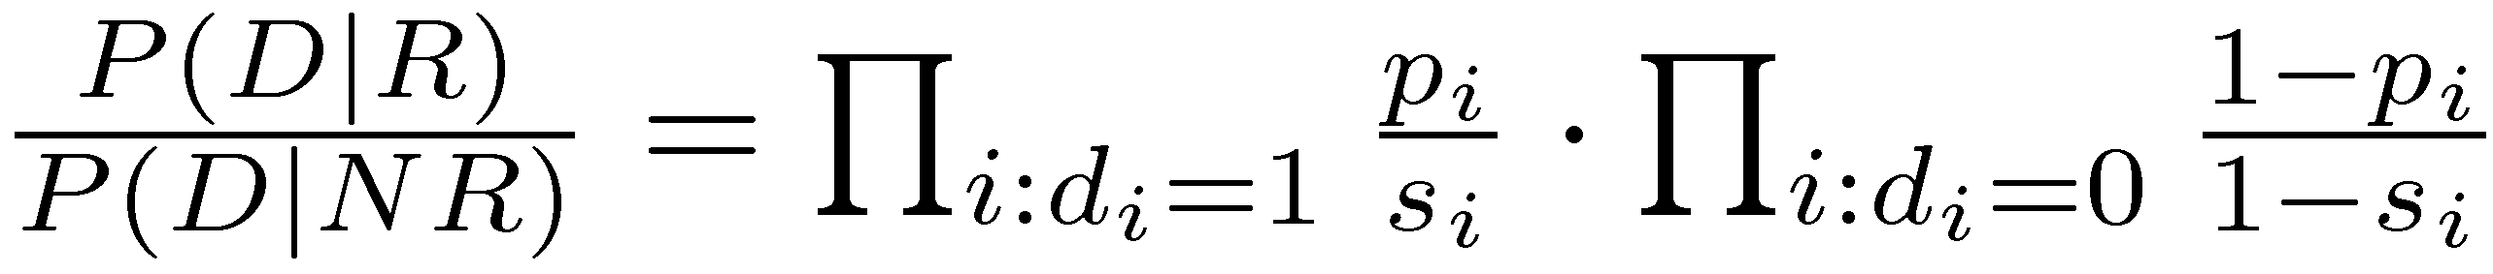
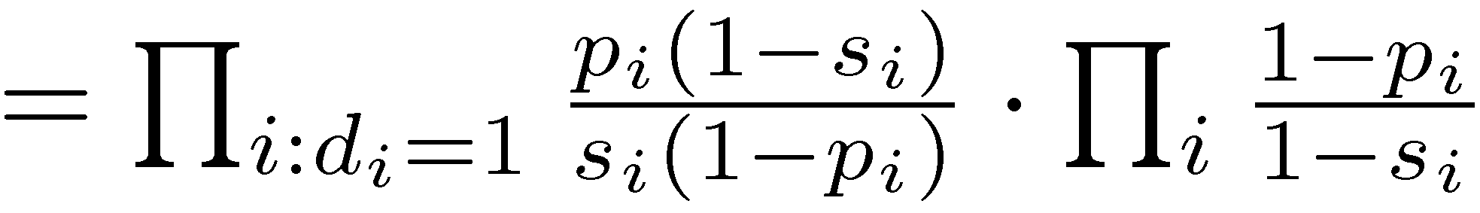
Binary Independence Model
Document-independent
- p_{i} is probability that term i occurs in relevant document,
- s_{i} is probability that term i occurs in non-relevant document

Slide 21
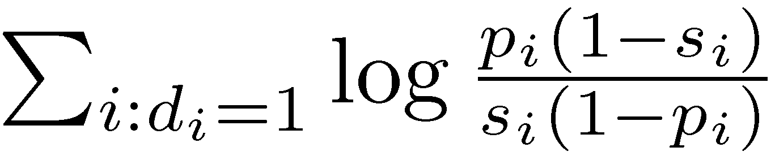
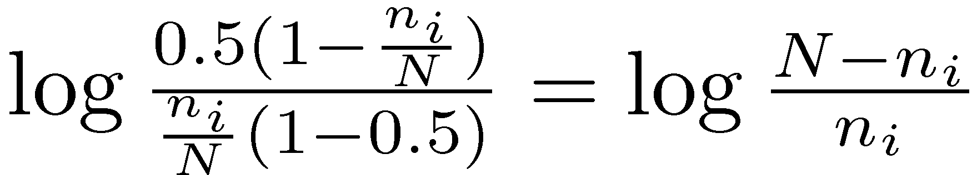
Binary Independence Model
Scoring function is
Query provides information about relevant documents
If we assume p_{i} constant for terms in query, s_{i} approximated by entire collection, get idf-like weight

Slide 22
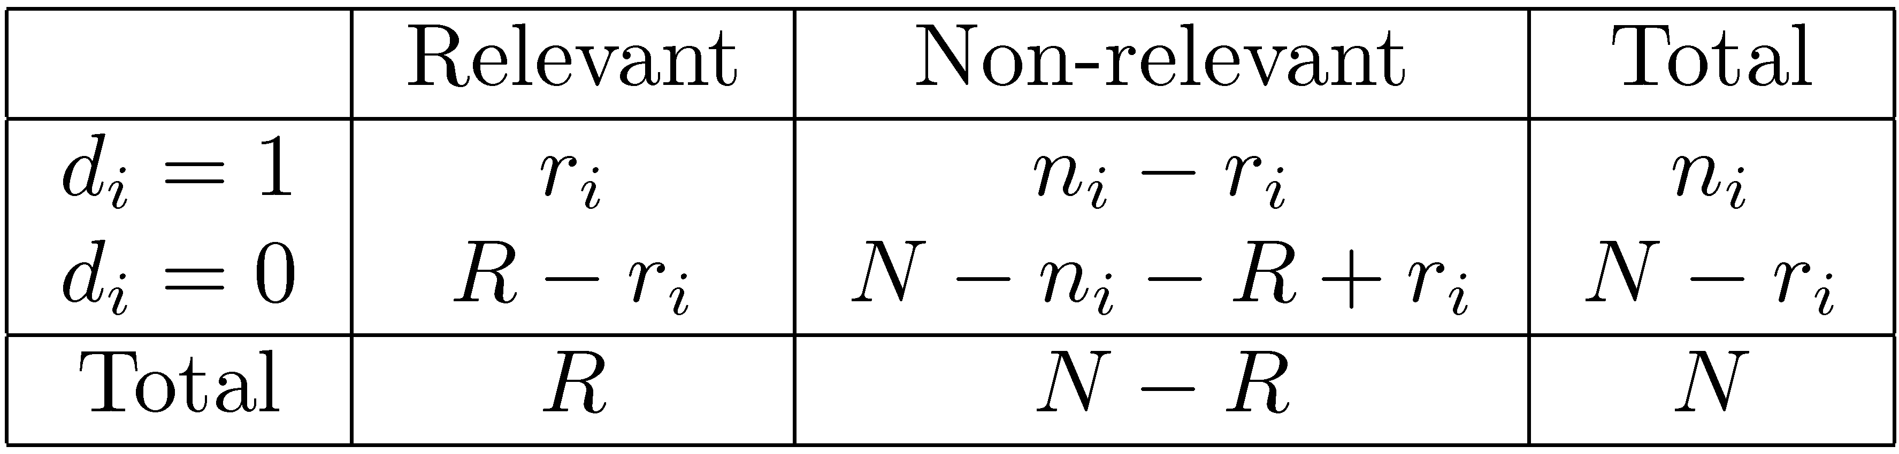
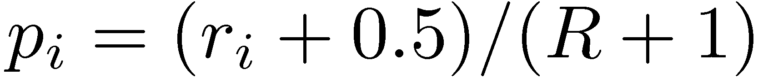
Contingency Table
N - n_{i}
n_{i}: # docs with di=1, that is, that contain term i
N: total # docs in collection
R: # relevant docs
Gives scoring function:

Slide 23
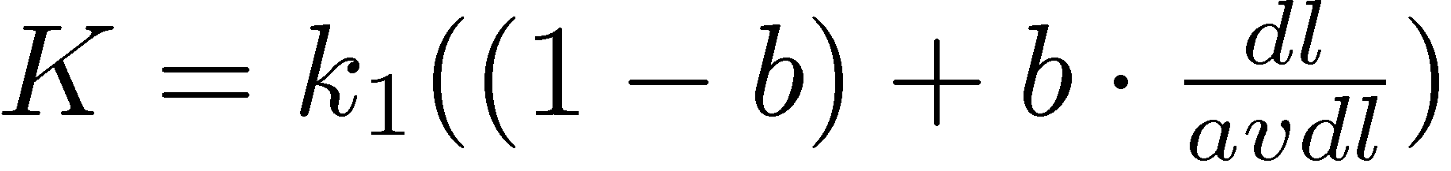
BM25
Popular and effective ranking algorithm based on binary independence model
adds document and query term weights
k1, k2 and K are parameters whose values are set empirically
dl is doc length
Typical TREC value for k1 is 1.2, k2 varies from 0 to 1000, b = 0.75
qf_{i}: query frequency of term i

Slide 24
BM25 Example
Query with two terms, “president lincoln”, (qf = 1)
No relevance information (r and R are zero)
N = 500,000 documents
“president” occurs in 40,000 documents (n₁ = 40, 000)
“lincoln” occurs in 300 documents (n₂ = 300)
“president” occurs 15 times in doc (f₁ = 15)
“lincoln” occurs 25 times (f₂ = 25)
document length is 90% of the average length (dl/avdl = .9)
k₁ = 1.2, b = 0.75, and k₂ = 100
K = 1.2 · (0.25 + 0.75 · 0.9) = 1.11

Slide 25
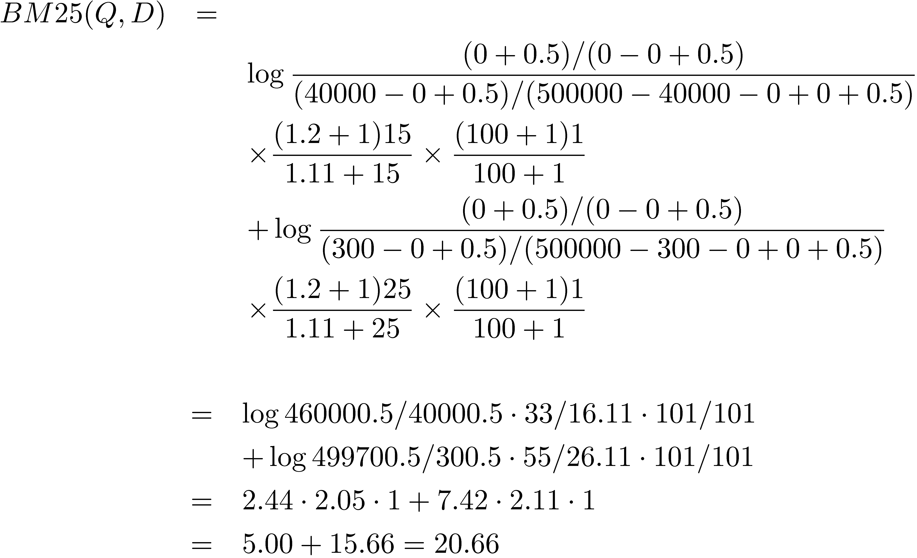
BM25 Example
Note: we use base e here

Slide 26
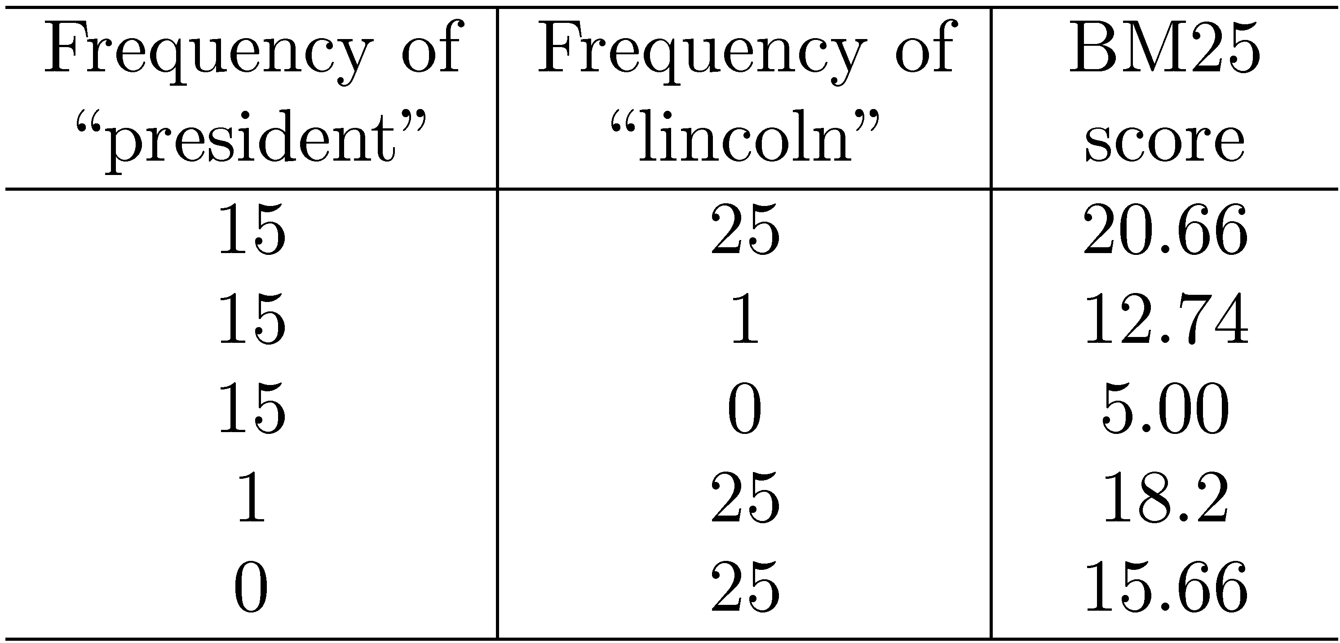
BM25 Example
Effect of term frequencies

Slide 27
Language Model
Unigram language model
probability distribution over the words in a language
generation of text consists of pulling words out of a “bucket” according to the probability distribution and replacing them
N-gram language model
some applications use bigram and trigram language models where probabilities depend on previous words

Slide 28
Language Model
A topic in a document or query can be represented as a language model
i.e., words that tend to occur often when discussing a topic will have high probabilities in the corresponding language model
Multinomial distribution over words
text is modeled as a finite sequence of words, where there are t possible words at each point in the sequence
commonly used, but not only possibility
doesn’t model burstiness (i.e. if a word is selected, it has higher probability to be re-selected)

Slide 29
LMs for Retrieval
3 possibilities:
probability of generating the query text from a document language model
probability of generating the document text from a query language model
comparing the language models representing the query and document topics
Models of topical relevance

Slide 30
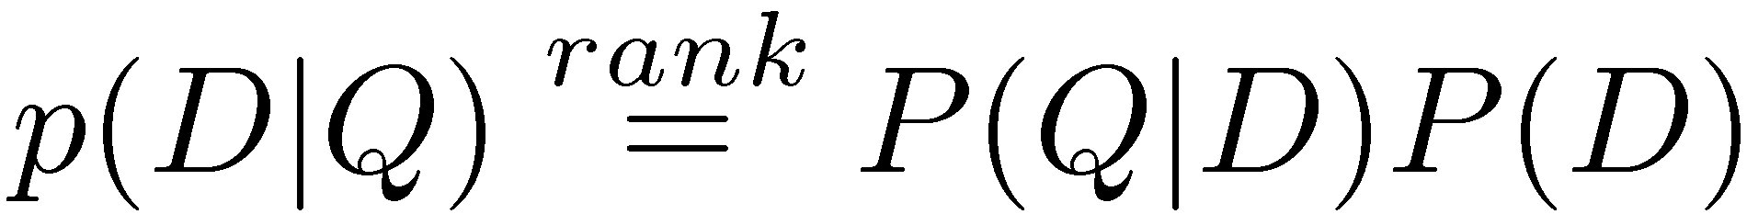
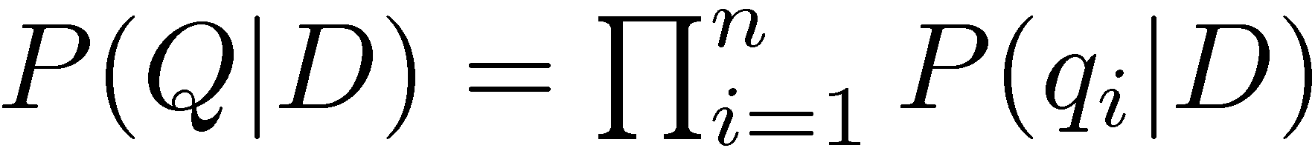
Query-Likelihood Model
Rank documents by the probability that the query could be generated by the document model (i.e. same topic)
Given query, start with P(D|Q)
Using Bayes’ Rule
Assuming prior is uniform, unigram model

Slide 31
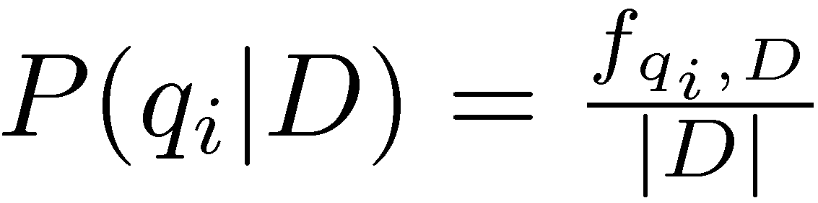
Estimating Probabilities
Obvious estimate for unigram probabilities is
Maximum likelihood estimate
makes the observed value of fqi;D most likely
Drawback: If query words are missing from document, score will be zero
Missing 1 out of 4 query words same as missing 3 out of 4

Slide 32
Smoothing
Document texts are a sample from the language model
Missing words should not have zero probability of occurring
Smoothing is a technique for estimating probabilities for missing (or unseen) words
lower (or discount) the probability estimates for words that are seen in the document text
assign that “left-over” probability to the estimates for the words that are not seen in the text

Slide 33
Estimating Probabilities
Estimate for unseen words is α_{D}P(q_{i}|C)
P(q_{i}|C) is the probability for query word i in the collection language model for collection C (background probability)
α_{D} is a parameter
Estimate for words that occur is
(1 − α_{D}) P(q_{i}|D) + α_{D} P(q_{i}|C)
Different forms of estimation come from different α_{D}

Slide 34
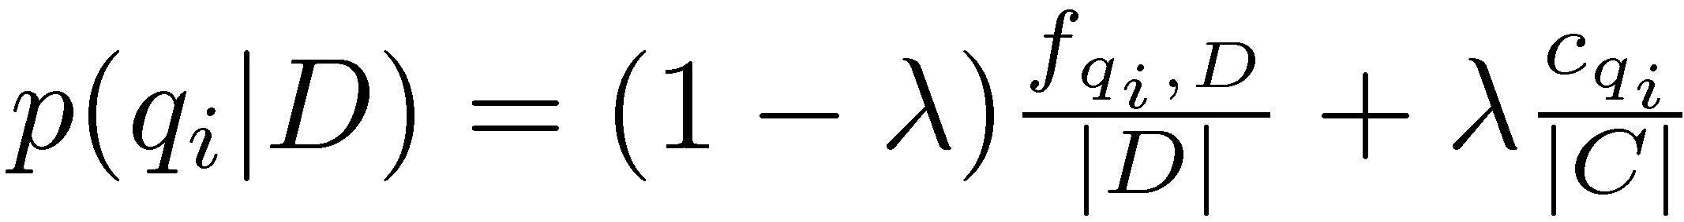
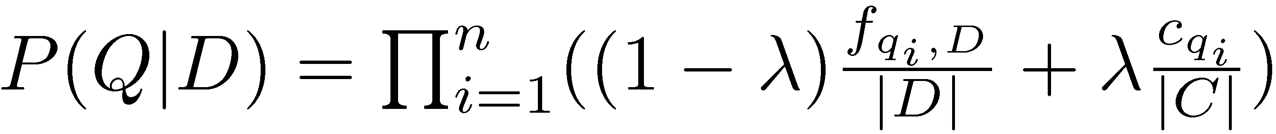
Jelinek-Mercer Smoothing
α_{D} is a constant, λ
Gives estimate of
Ranking score
Use logs for convenience
accuracy problems multiplying small numbers
Found that a good choice is λ=0.1 for short queries and λ=0.7 for long.
c_{qi}: frequency of term q_{i} in collection C

Slide 35
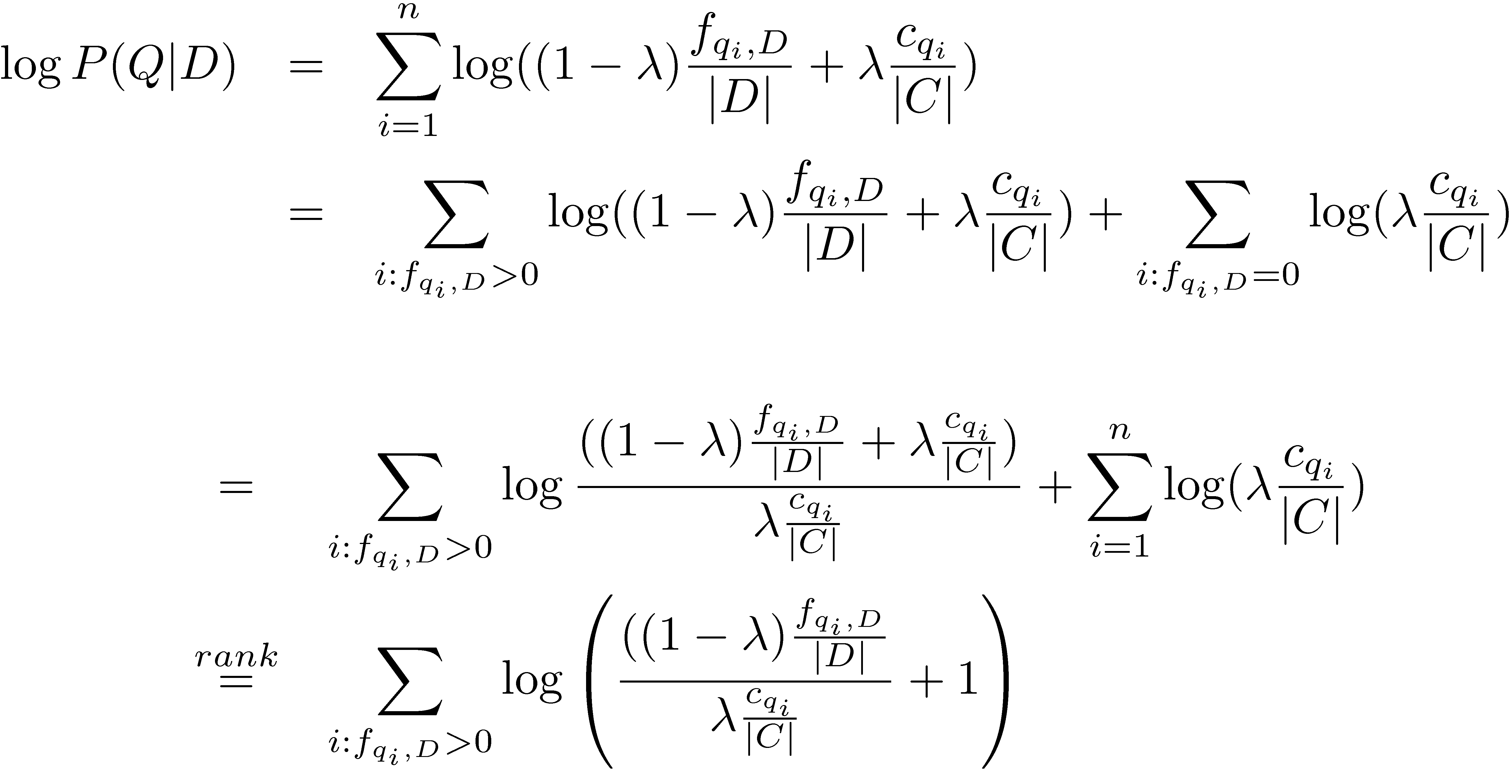
Where is tf.idf Weight?
n: # terms in query Q
- proportional to the term frequency, inversely proportional to the collection frequency

Slide 36
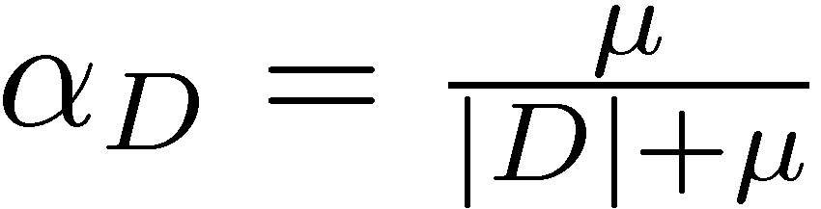
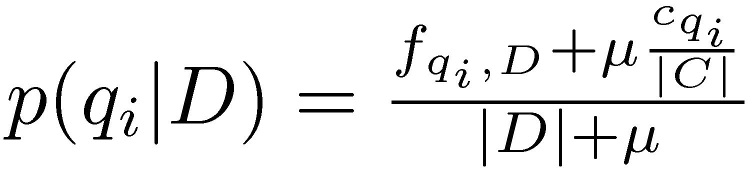
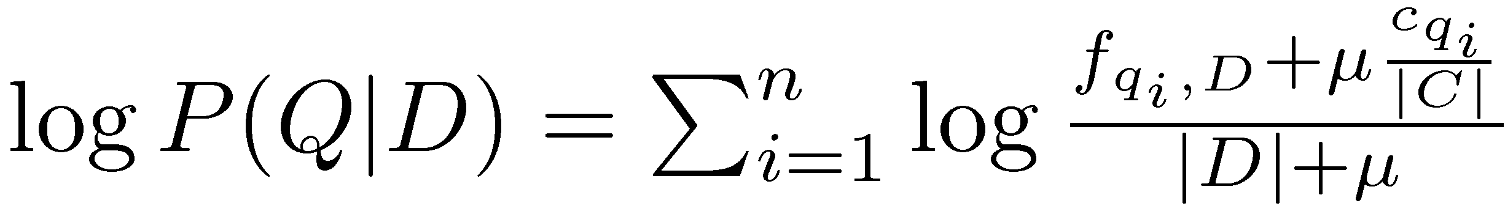
Dirichlet Smoothing
α_{D} depends on document length
Gives probability estimation of
and document score
μ=2000 used in practice
What happens when |D| almost 0?

Slide 37
Query Likelihood Example
For the term “president”
f_{qi,D} = 15, c_{qi} = 160,000
For the term “lincoln”
f_{qi,D} = 25, c_{qi} = 2,400
number of word occurrences in the document |d| is assumed to be 1,800
number of word occurrences in the collection is 10⁹
500,000 documents times an average of 2,000 words
μ = 2,000

Slide 38
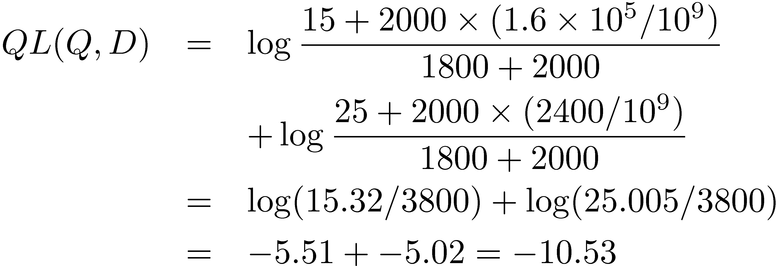
Query Likelihood Example
Negative number because summing logs of small numbers

Slide 39
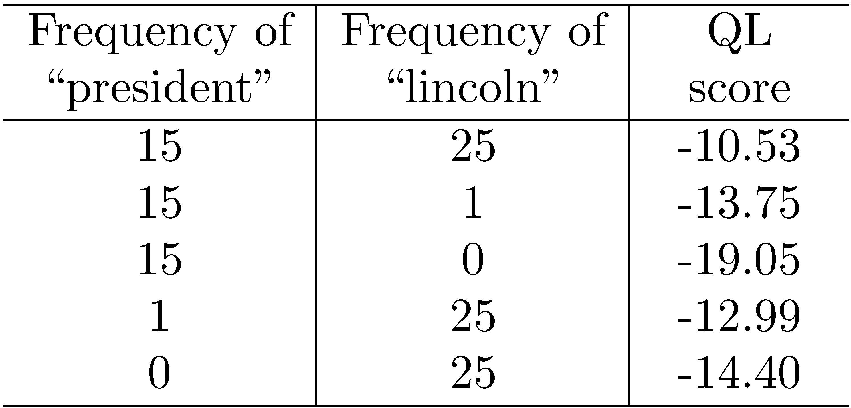
Query Likelihood Example

Slide 40
Learning to Rank – Use Machine Learning
Introduction to Information Retrieval
Modern systems – especially on the Web – use a great number of features:
Arbitrary useful features – not a single unified model
Log frequency of query word in anchor text?
Query word in color on page?
# of images on page?
# of (out) links on page?
PageRank of page?
URL length?
URL contains “~”?
Page edit recency?
Page length?
The New York Times (2008-06-03) quoted Amit Singhal as saying Google was using over 200 such features.

Slide 41
Learning to Rank
Training data is
r is partial rank information
if document da should be ranked higher than db, then (da, db) ∈ ri
partial rank information comes from relevance judgments (allows multiple levels of relevance) or click data
e.g., d1, d2 and d3 are the documents in the first, second and third rank of the search output, only d3 clicked on → (d3, d1) and (d3, d2) will be in desired ranking for this query

Slide 42
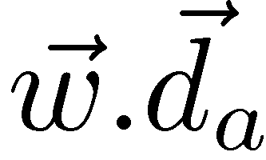
Learning to Rank
Learning a linear ranking function
where w is a weight vector that is adjusted by learning
d_{a} is the vector representation of the features of document
non-linear functions also possible
Weights represent importance of features
learned using training data
e.g.,

Slide 43
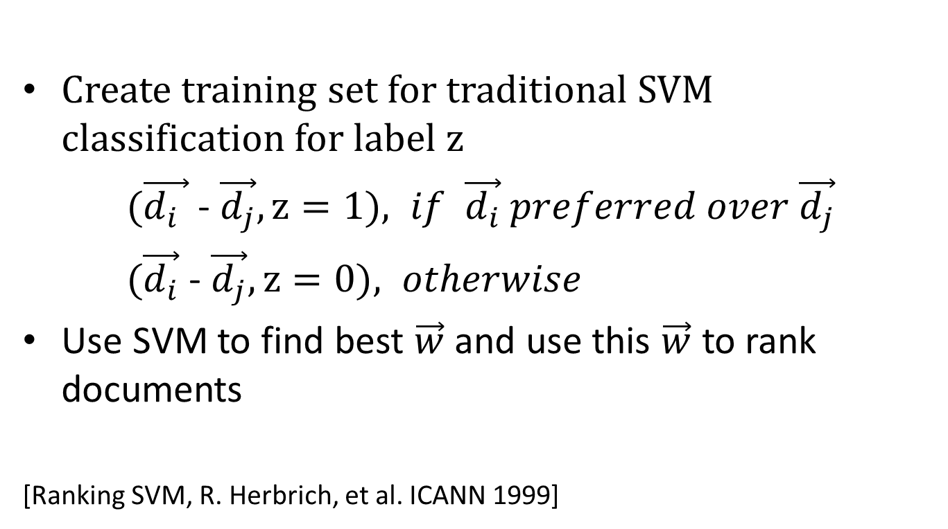
Ranking SVM
Create training set for traditional SVM classification for label z
$(\vec{d_{i} }$ - $\vec{d_{j}}, z=1), if \vec{d_{i}} preferred over \vec{d_{j}}$
$(\vec{d_{i}}$ - $\vec{d_{j}}, z=0), otherwise$
Use SVM to find best $\vec{w}$ and use this $\vec{w}$ to rank documents
[Ranking SVM, R. Herbrich, et al. ICANN 1999]

Slide 44
End (up to just before 7.3.2)

Slide 45
Extra Slides

Slide 46
Relevance Models
Relevance model – language model representing information need
query and relevant documents are samples from this model
P(D|R) - probability of generating the text in a document given a relevance model
document likelihood model
less effective than query likelihood due to difficulties comparing across documents of different lengths

Slide 47
Pseudo-Relevance Feedback
Estimate relevance model from query and top-ranked documents
Rank documents by similarity of document model to relevance model
Kullback-Leibler divergence (KL-divergence) is a well-known measure of the difference between two probability distributions

Slide 48
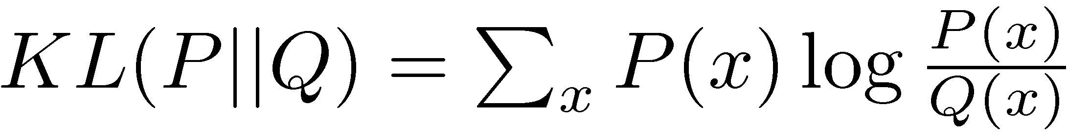
KL-Divergence
Given the true probability distribution P and another distribution Q that is an approximation to P,
Use negative KL-divergence for ranking, and assume relevance model R is the true distribution (not symmetric),

Slide 49
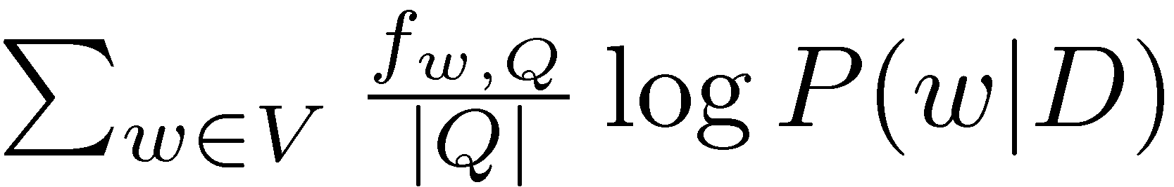
KL-Divergence
Given a simple maximum likelihood estimate for P(w|R), based on the frequency in the query text, ranking score is
rank-equivalent to query likelihood score
Query likelihood model is a special case of retrieval based on relevance model

Slide 50
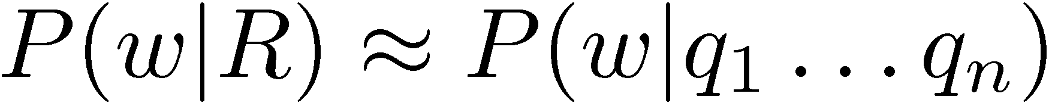
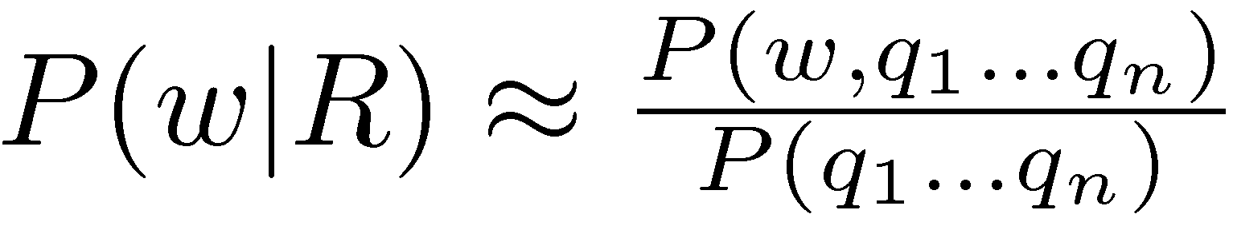
Estimating the Relevance Model
Probability of pulling a word w out of the “bucket” representing the relevance model depends on the n query words we have just pulled out
By definition

Slide 51
Estimating the Relevance Model
Joint probability is
Assume
Gives

Slide 52
Estimating the Relevance Model
P(D) usually assumed to be uniform
P(w, q1 . . . qn) is simply a weighted average of the language model probabilities for w in a set of documents, where the weights are the query likelihood scores for those documents
Formal model for pseudo-relevance feedback
query expansion technique

Slide 53
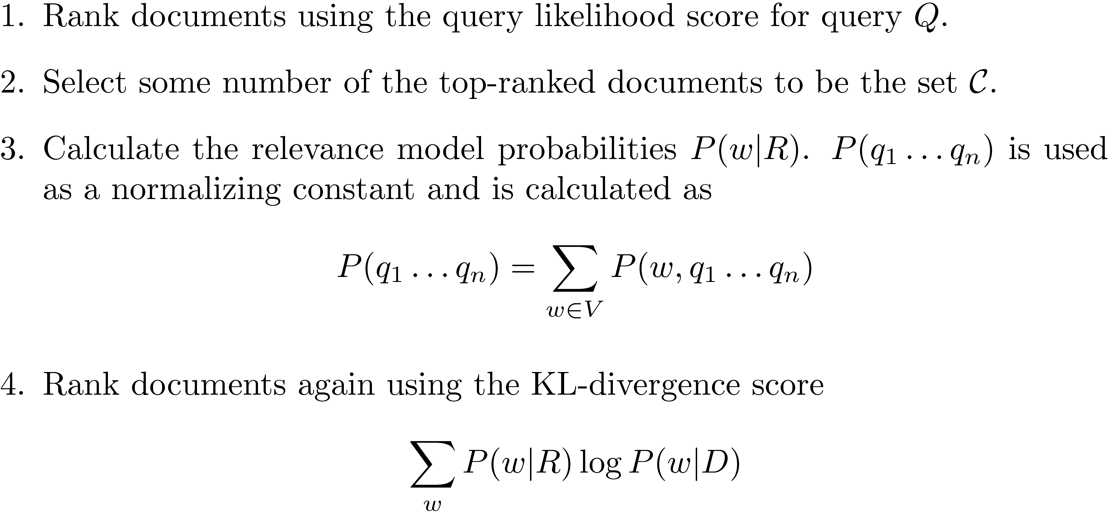
Pseudo-Feedback Algorithm

Slide 54
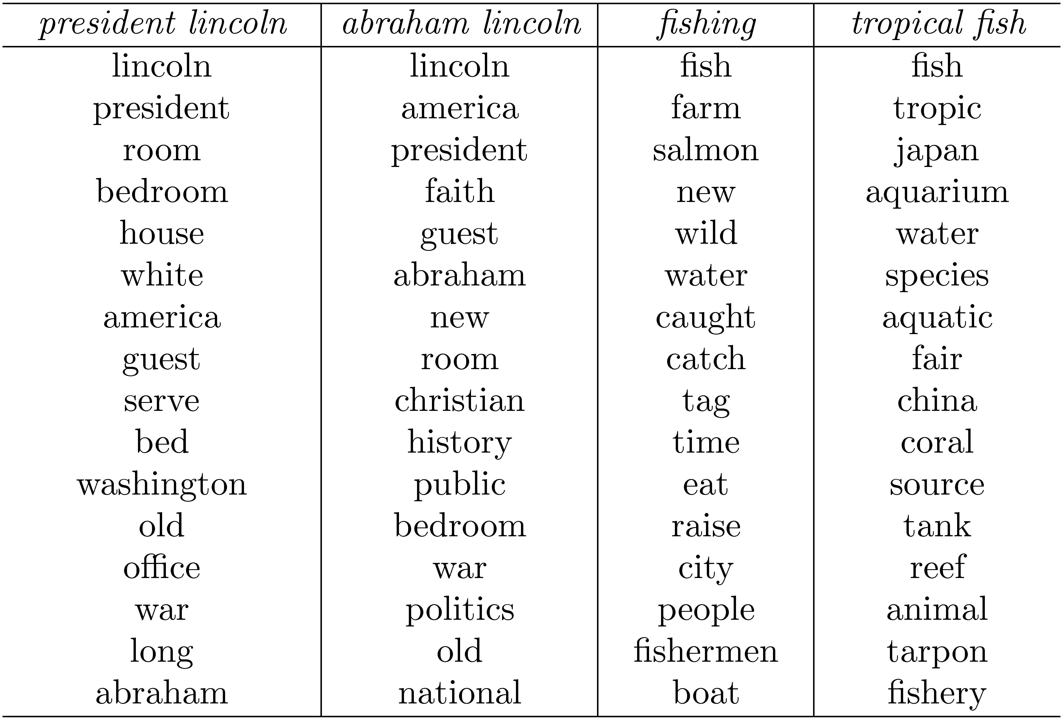
Example from Top 10 Docs

Slide 55
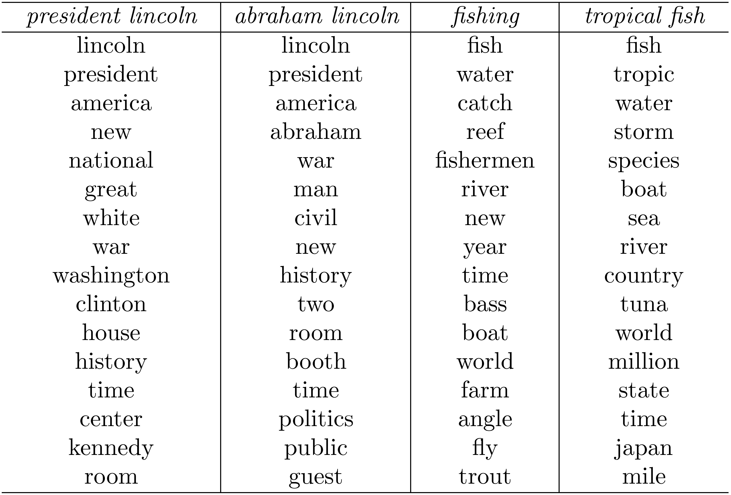
Example from Top 50 Docs

Slide 56
Combining Evidence
Effective retrieval requires the combination of many pieces of evidence about a document’s potential relevance
have focused on simple word-based evidence
many other types of evidence
structure, PageRank, metadata, even scores from different models
Inference network model is one approach to combining evidence
uses Bayesian network formalism

Slide 57
Inference Network

Slide 58
Inference Network
Document node (D) corresponds to the event that a document is observed
Representation nodes (r_{i}) are document features (evidence)
Probabilities associated with those features are based on language models θ estimated using the parameters μ
one language model for each significant document structure
r_{i} nodes can represent proximity features, or other types of evidence (e.g. date)

Slide 59
Inference Network
Query nodes (q_{i}) are used to combine evidence from representation nodes and other query nodes
represent the occurrence of more complex evidence and document features
a number of combination operators are available
Information need node (I) is a special query node that combines all of the evidence from the other query nodes
network computes P(I|D, μ)

Slide 60
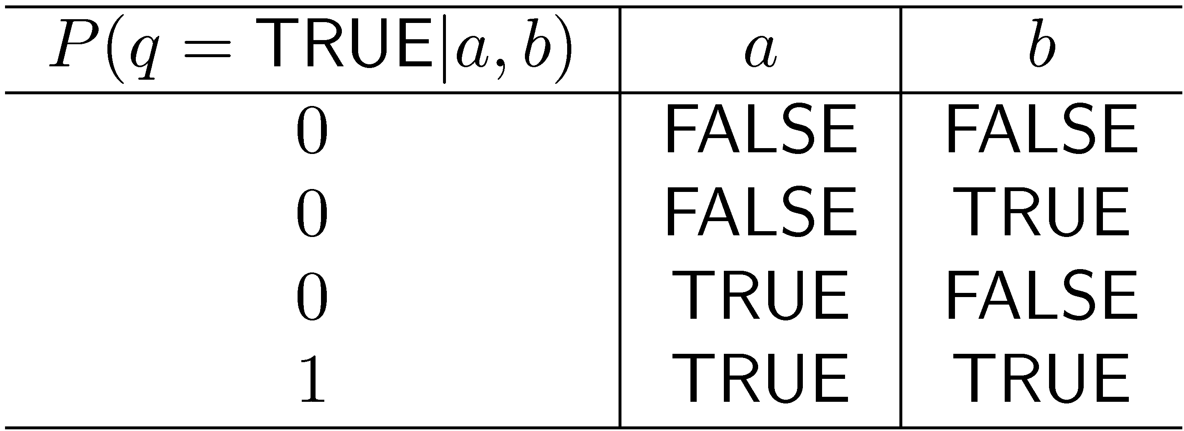
Example: AND Combination
a and b are parent nodes for q

Slide 61
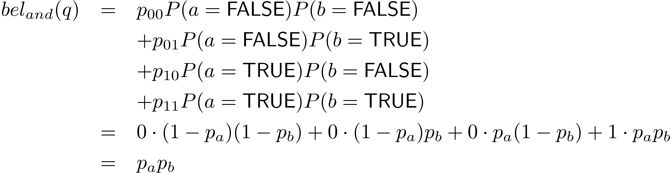
Example: AND Combination
Combination must consider all possible states of parents
Some combinations can be computed efficiently

Slide 62
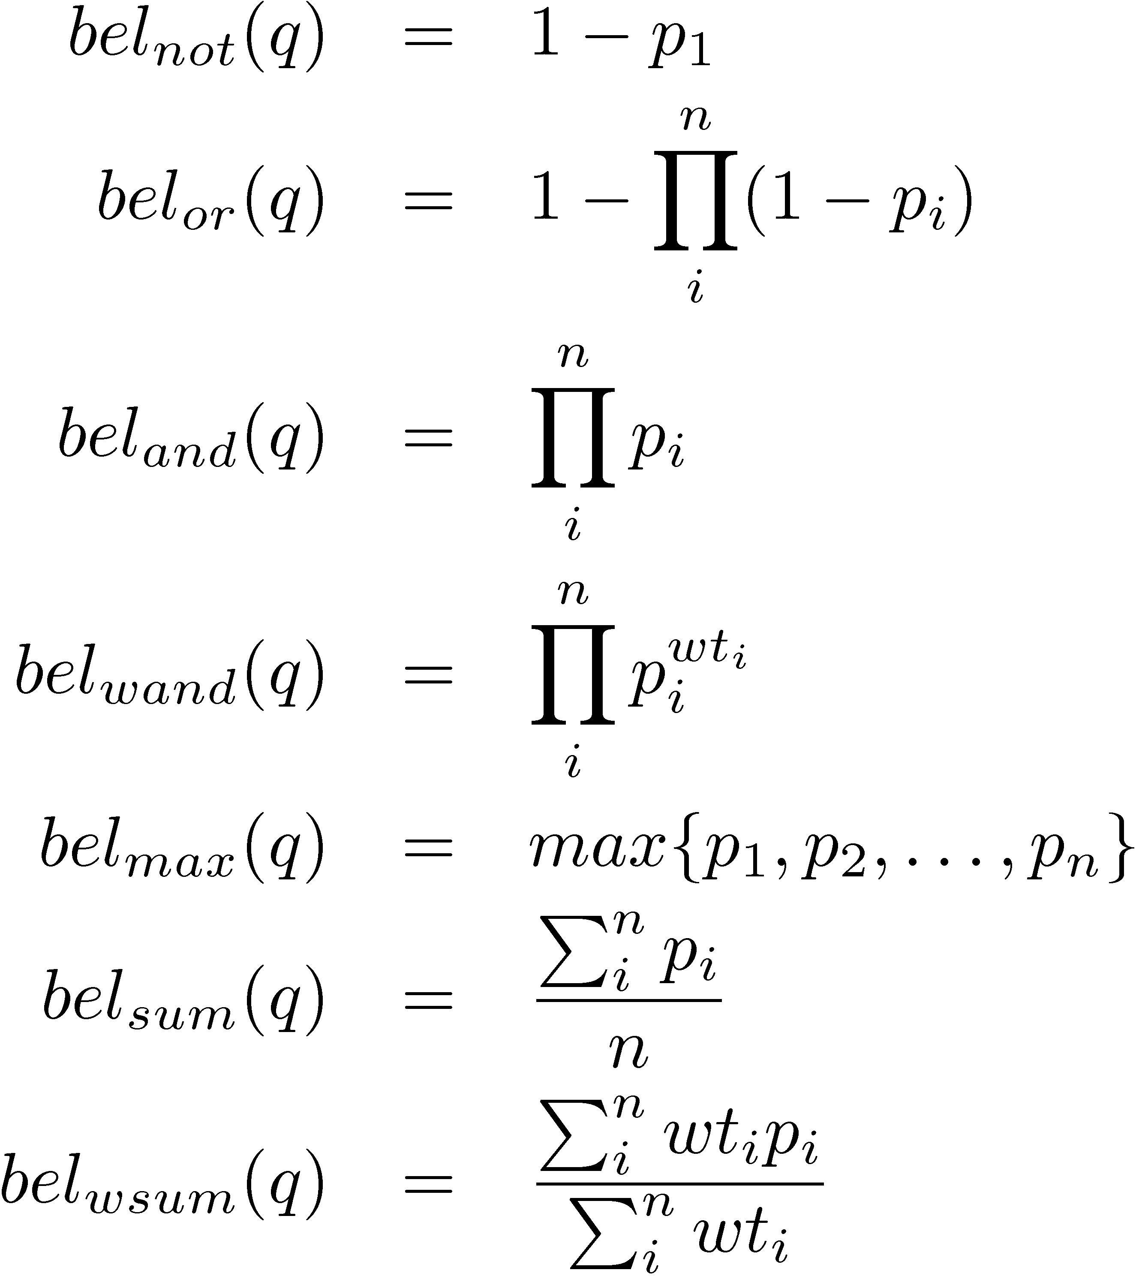
Inference Network Operators

Slide 63
Galago Query Language
A document is viewed as a sequence of text that may contain arbitrary tags
A single context is generated for each unique tag name
An extent is a sequence of text that appears within a single begin/end tag pair of the same type as the context

Slide 64

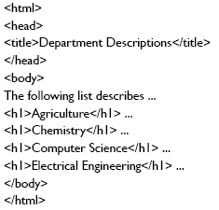


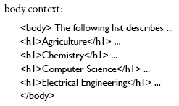
Galago Query Language

Slide 65
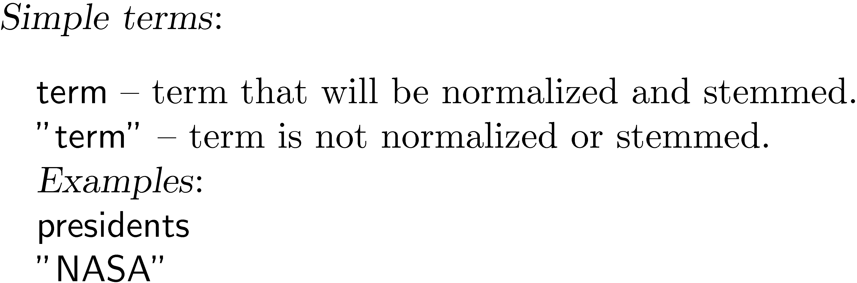
Galago Query Language
TexPoint Display

Slide 66
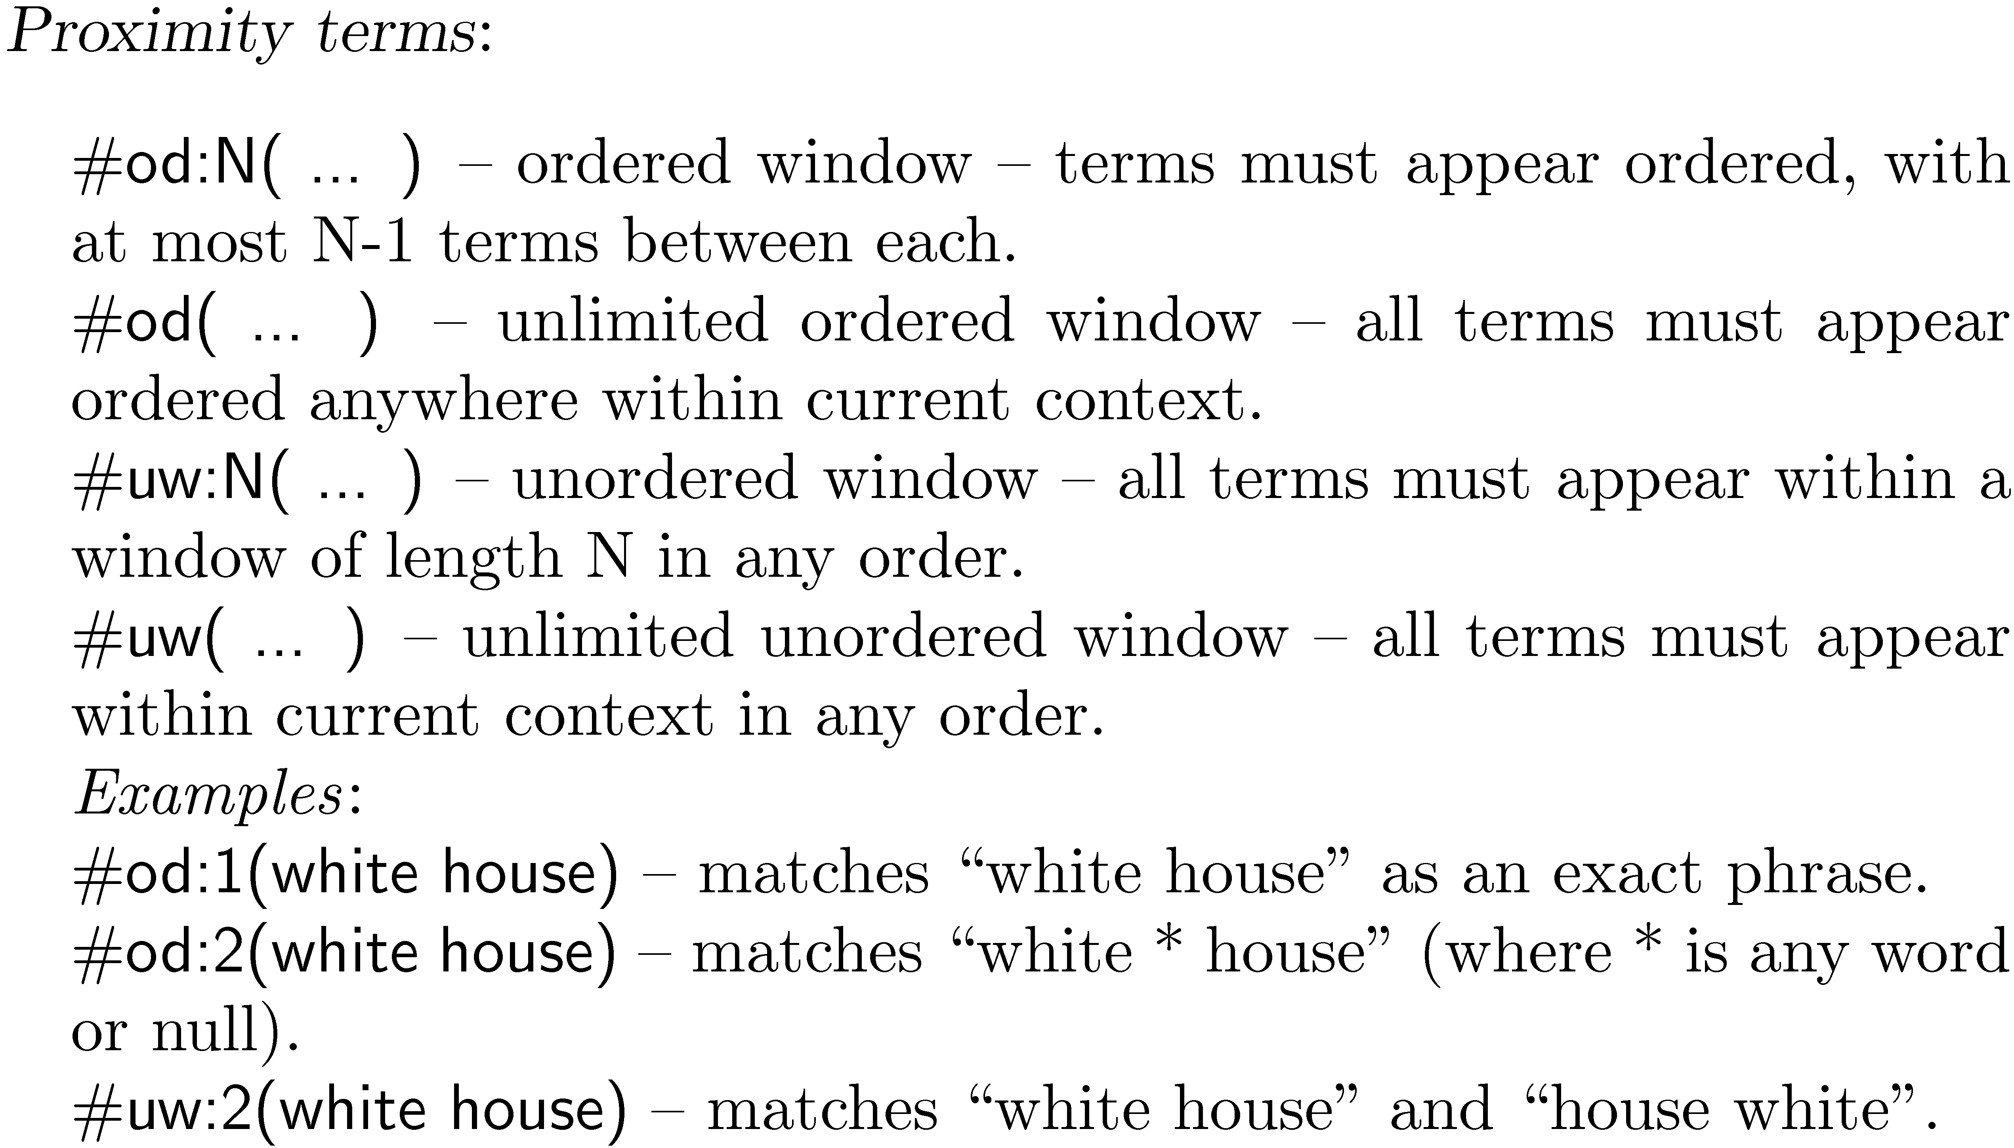
Galago Query Language

Slide 67
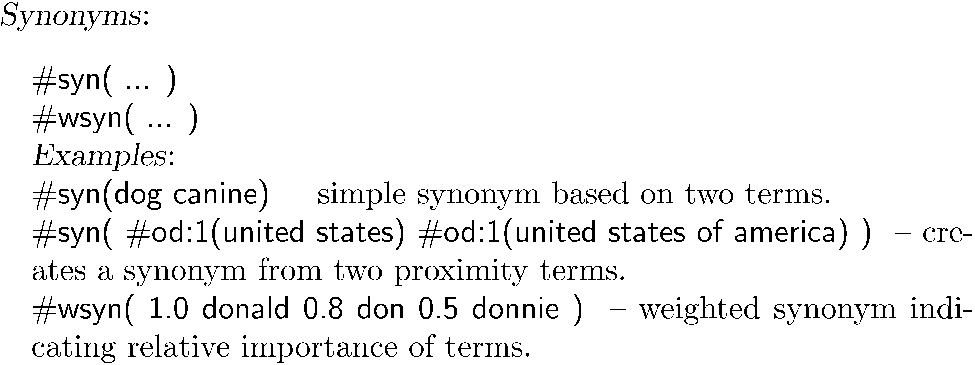
Galago Query Language

Slide 68
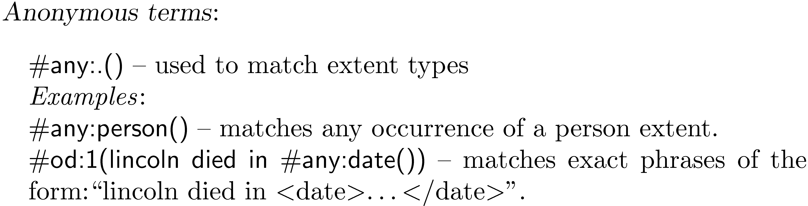
Galago Query Language

Slide 69
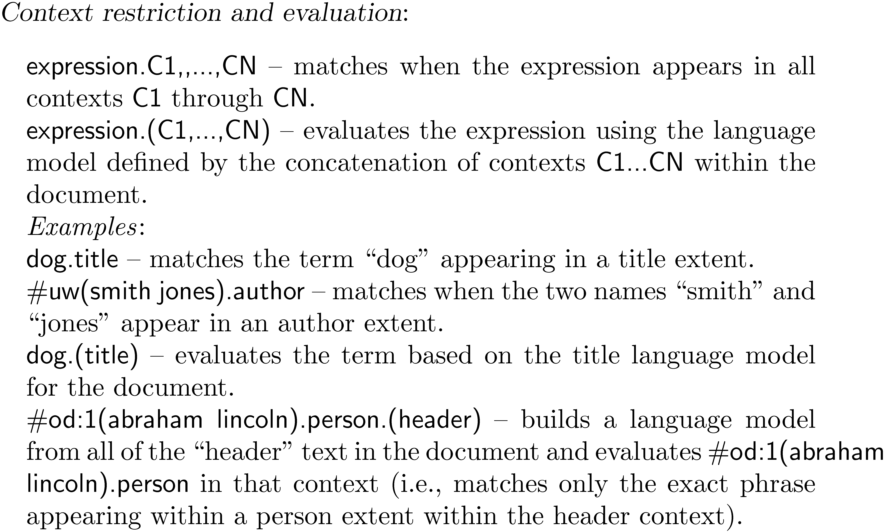
Galago Query Language

Slide 70

Galago Query Language

Slide 71

Galago Query Language

Slide 72
Web Search
Most important, but not only, search application
Major differences to TREC news
Size of collection
Connections between documents
Range of document types
Importance of spam
Volume of queries
Range of query types

Slide 73
Search Taxonomy
Informational
Finding information about some topic which may be on one or more web pages
Topical search
Navigational
finding a particular web page that the user has either seen before or is assumed to exist
Transactional
finding a site where a task such as shopping or downloading music can be performed

Slide 74
Web Search
For effective navigational and transactional search, need to combine features that reflect user relevance
Commercial web search engines combine evidence from hundreds of features to generate a ranking score for a web page
page content, page metadata, anchor text, links (e.g., PageRank), and user behavior (click logs)
page metadata – e.g., “age”, how often it is updated, the URL of the page, the domain name of its site, and the amount of text content

Slide 75
Search Engine Optimization
SEO: understanding the relative importance of features used in search and how they can be manipulated to obtain better search rankings for a web page
e.g., improve the text used in the title tag, improve the text in heading tags, make sure that the domain name and URL contain important keywords, and try to improve the anchor text and link structure
Some of these techniques are regarded as not appropriate by search engine companies

Slide 76
Web Search
In TREC evaluations, most effective features for navigational search are:
text in the title, body, and heading (h1, h2, h3, and h4) parts of the document, the anchor text of all links pointing to the document, the PageRank number, and the inlink count
Given size of Web, many pages will contain all query terms
Ranking algorithm focuses on discriminating between these pages
Word proximity is important

Slide 77

Term Proximity
Many models have been developed
N-grams are commonly used in commercial web search
Dependence model based on inference net has been effective in TREC - e.g.

Slide 78

Example Web Query

Slide 79
Machine Learning and IR
Considerable interaction between these fields
Rocchio algorithm (60s) is a simple learning approach
80s, 90s: learning ranking algorithms based on user feedback
2000s: text categorization
Limited by amount of training data
Web query logs have generated new wave of research
e.g., “Learning to Rank”

Slide 80
Generative vs. Discriminative
All of the probabilistic retrieval models presented so far fall into the category of generative models
A generative model assumes that documents were generated from some underlying model (in this case, usually a multinomial distribution) and uses training data to estimate the parameters of the model
probability of belonging to a class (i.e. the relevant documents for a query) is then estimated using Bayes’ Rule and the document model

Slide 81
Generative vs. Discriminative
A discriminative model estimates the probability of belonging to a class directly from the observed features of the document based on the training data
Generative models perform well with low numbers of training examples
Discriminative models usually have the advantage given enough training data
Can also easily incorporate many features

Slide 82
Discriminative Models for IR
Discriminative models can be trained using explicit relevance judgments or click data in query logs
Click data is much cheaper, more noisy
e.g. Ranking Support Vector Machine (SVM) takes as input partial rank information for queries
partial information about which documents should be ranked higher than others

Slide 83

Ranking SVM
ξ, known as a slack variable, allows for misclassification of difficult or noisy training examples, and C is a parameter that is used to prevent overfitting

Slide 84


Ranking SVM
Software available to do optimization
Each pair of documents in our training data can be represented by the vector:
Score for this pair is:
SVM classifier will find a w that makes the smallest score as large as possible
make the differences in scores as large as possible for the pairs of documents that are hardest to rank

Slide 85
Topic Models
Improved representations of documents
can also be viewed as improved smoothing techniques
improve estimates for words that are related to the topic(s) of the document
instead of just using background probabilities
Approaches
Latent Semantic Indexing (LSI)
Probabilistic Latent Semantic Indexing (pLSI)
Latent Dirichlet Allocation (LDA)

Slide 86

LDA
Model document as being generated from a mixture of topics

Slide 87

LDA
Gives language model probabilities
Used to smooth the document representation by mixing them with the query likelihood probability as follows:

Slide 88
LDA
If the LDA probabilities are used directly as the document representation, the effectiveness will be significantly reduced because the features are too smoothed
e.g., in typical TREC experiment, only 400 topics used for the entire collection
generating LDA topics is expensive
When used for smoothing, effectiveness is improved

Slide 89

LDA Example
Top words from 4 LDA topics from TREC news

Slide 90
Summary
Best retrieval model depends on application and data available
Evaluation corpus (or test collection), training data, and user data are all critical resources
Open source search engines can be used to find effective ranking algorithms
Galago query language makes this particularly easy
Language resources (e.g., thesaurus) can make a big difference

